Slide 1


Parliamentary Library and Research Services
Towards an agenda for the next decade
October 6-8, 2021

Slide 2

Making parliamentary procedure machine readable
Anya Somerville & Michael Smethurst
Parliament of the United Kingdom

Slide 3
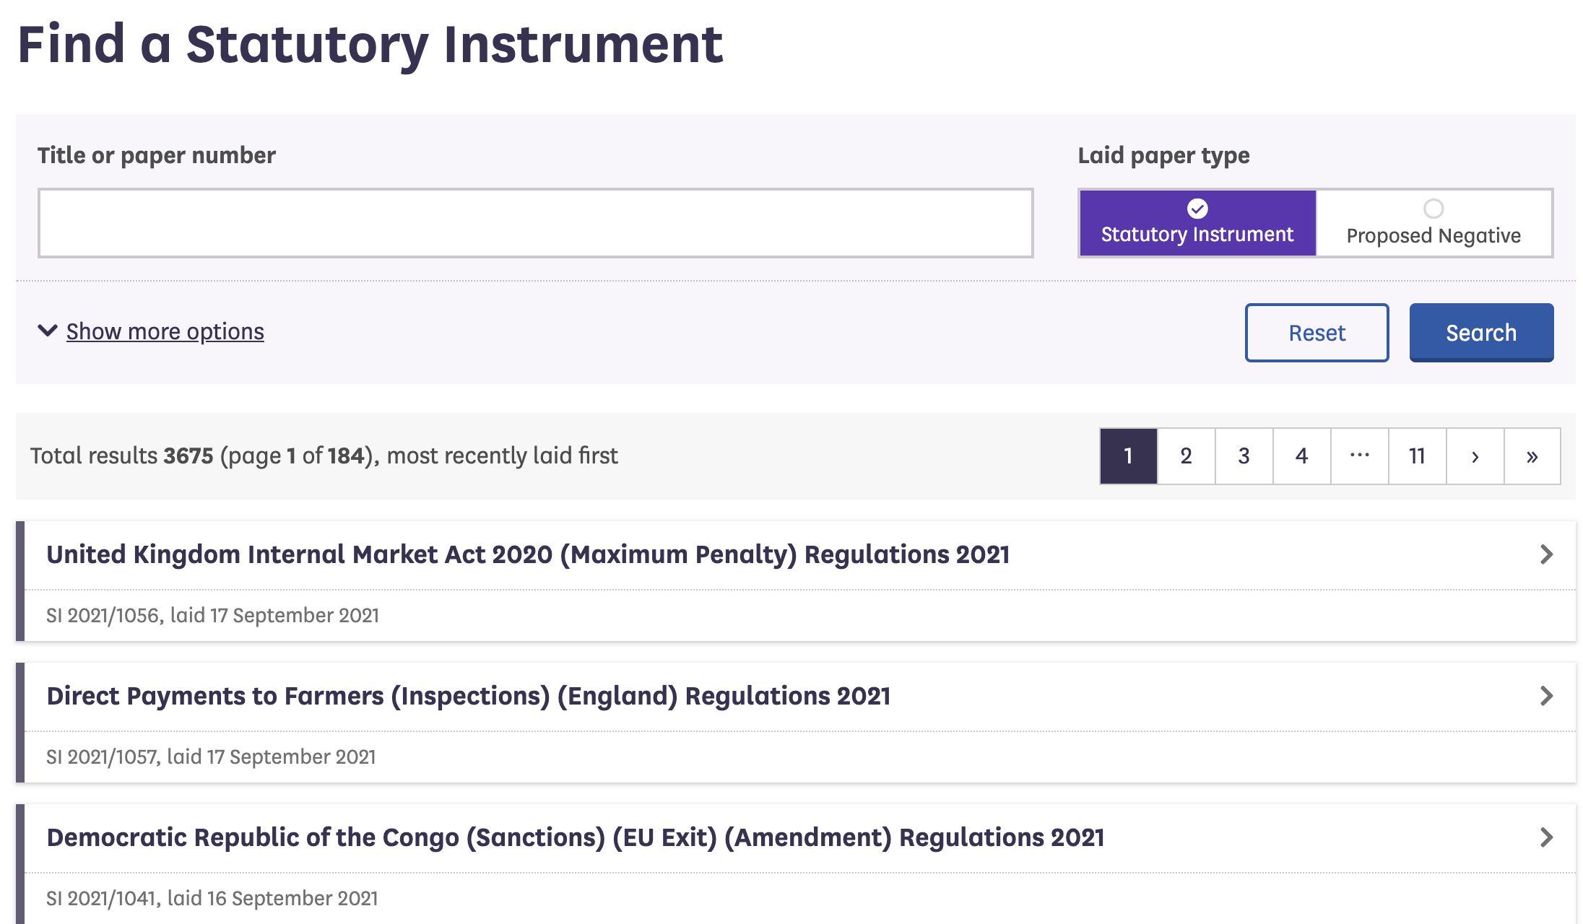

Notes:
In 2018 we were asked to make a publicly available Statutory Instrument tracking service. And we did. This is a talk about how.

Slide 4
An aside on Statutory Instruments
Notes:
First a little background on statutory instruments

Slide 5
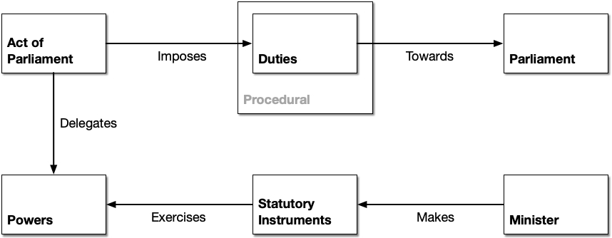
Notes:
For those new to Statutory Instruments
Acts delegate powers to ministers
A minister may choose to exercise that power by means of delegated legislation
If they do, they have certain duties
Some of those duties are towards Parliament
And some of those duties result in business according to parliamentary procedure
In the UK, statutory instruments are the most common form of delegated legislation

Slide 6
First Brexit, then the pandemic
Notes:
Most of the Brexit legislation was in the form of statutory instruments
So there was obviously some urgency
Since Brexit we’ve had the pandemic
Again the use of SIs to bring in emergency legislation has been marked

Slide 7
The problem we were trying to solve
Notes:
The problem we were trying to solve was how to reconcile disjointed information produced by individual offices

Slide 8
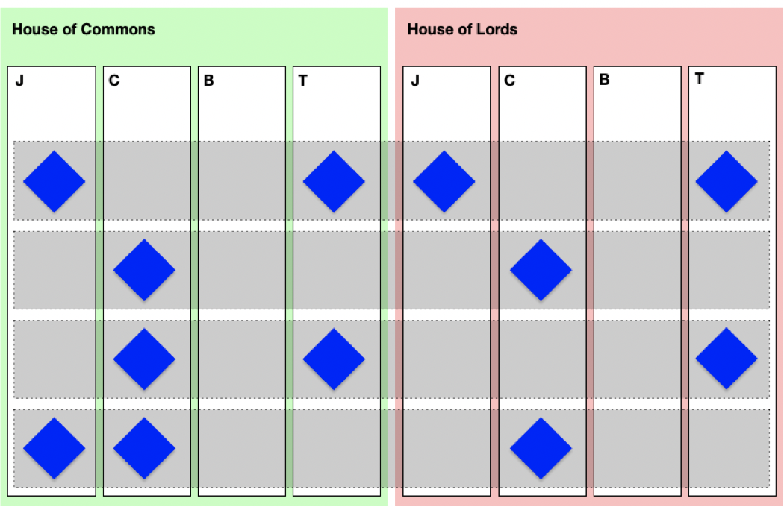
Notes:
Almost all offices in both Houses touch on SI procedure: both Journal Offices, both Table Offices and assorted committees
The information produced by these offices is disjointed
In order to track an SI one needs to know when 3 different committees typically meet, when they publish reports, where they publish reports and how to interpret those reports
Plus a dozen other forms of publication from Hansard to Early Day Motions to division records
People outside found it impossible to track the journey of an SI through Parliament
Even Members of Parliament may have struggled
Those Members who were also members of Delegated Legislation Committees were - pre pandemic - informed of this via a poster in the tea rooms
And researchers in the library found it difficult to impossible to answer enquiries on SIs

Slide 9
The importance of well-managed information
Notes:
We are information modellers and managers
We can work with colleagues to help them establish best practice for managing information
But it is often no-one’s job
And we cannot change people’s jobs or employ new people
You cannot machine learn your way to well managed information

Slide 10
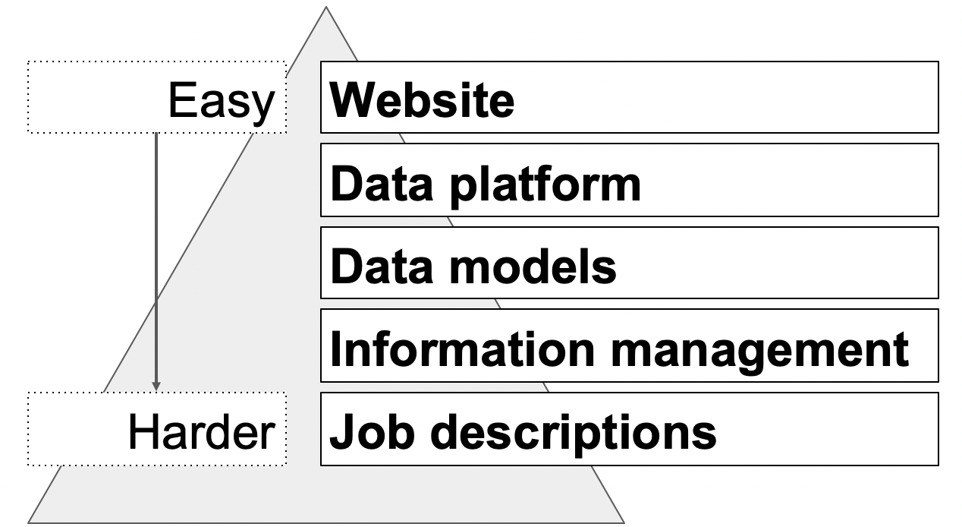
Notes:
At this point we turn to our trusty iceberg metaphor
Making websites is easy. Making visualisations is easy. Querying data is easy
Making a data platform and models that can cope with parliamentary business and flex as Parliament flexes is harder
Managing the information is harder still
Managing the information when it’s not in anyone’s job description starts to get impossible

Slide 11
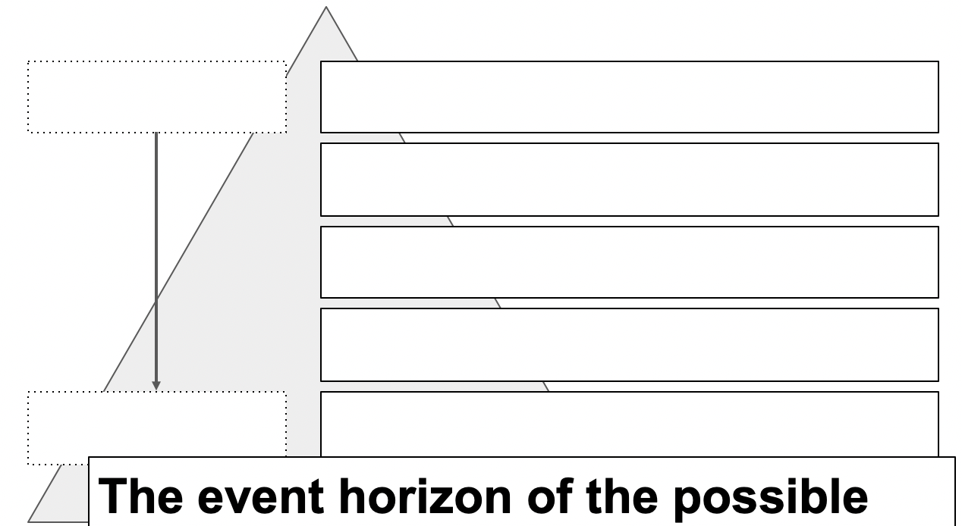
Notes:
And changing that means changing job descriptions and union negotiations
And you pretty quickly reach the event horizon of the possible

Slide 12
Your Finance Department controls your information management
Notes:
How software is commissioned and paid for is reflected in the shape of the software and in the shape of the data the software produces

Slide 13
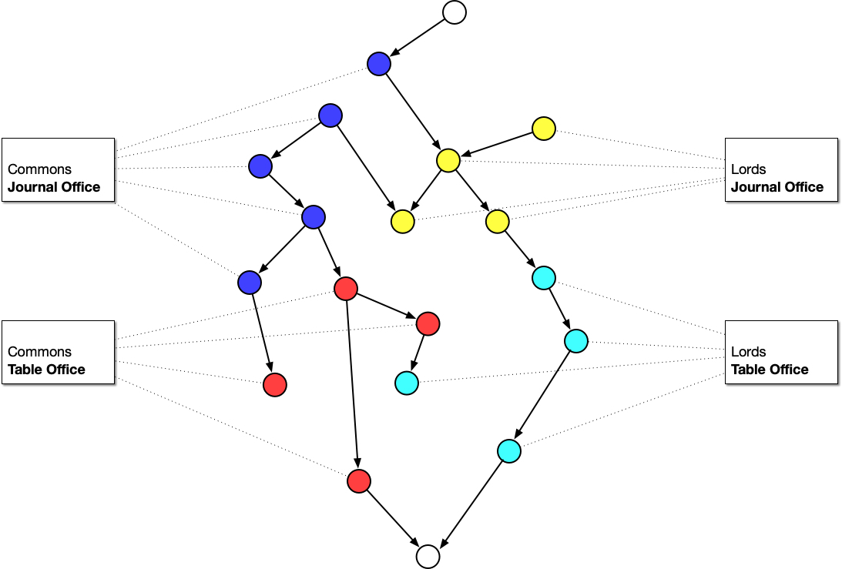
Notes:
Each office has their own view of the things they’re interested in
We often end up digitising existing office bound processes and missing out on the bigger picture
So no subset of information is ever bigger than the sum of its parts

Slide 14
Binding the correct contexts
Notes:
In order to make services that meet needs outside offices - be that querying services, websites, applications, visualisations - we need to step back and look for new patterns that don’t stop at office walls

Slide 15
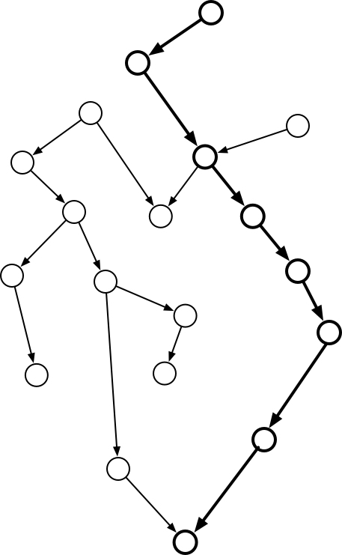
Notes:
In the Domain Driven Design world, people talk of bounded contexts
But these are bounded contexts in the sense of overlapping domains of knowledge
Not bounded in terms of balance sheets and how the software has been paid for

Slide 16
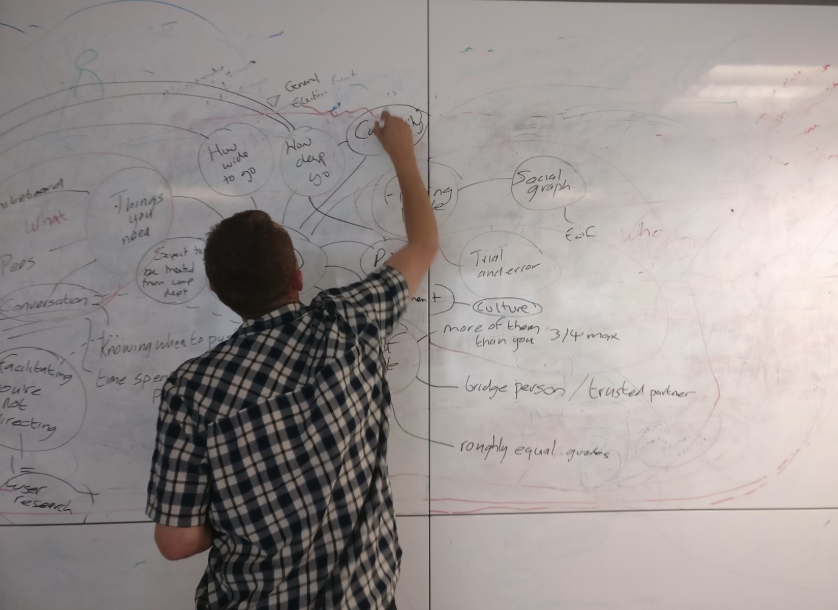
Notes:
So we work with lawyers and clerks - current and retired - to crosswalk the territory from as many angles as possible and use conversation and whiteboards to identify bounded contexts that make sense beyond any particular office

Slide 17
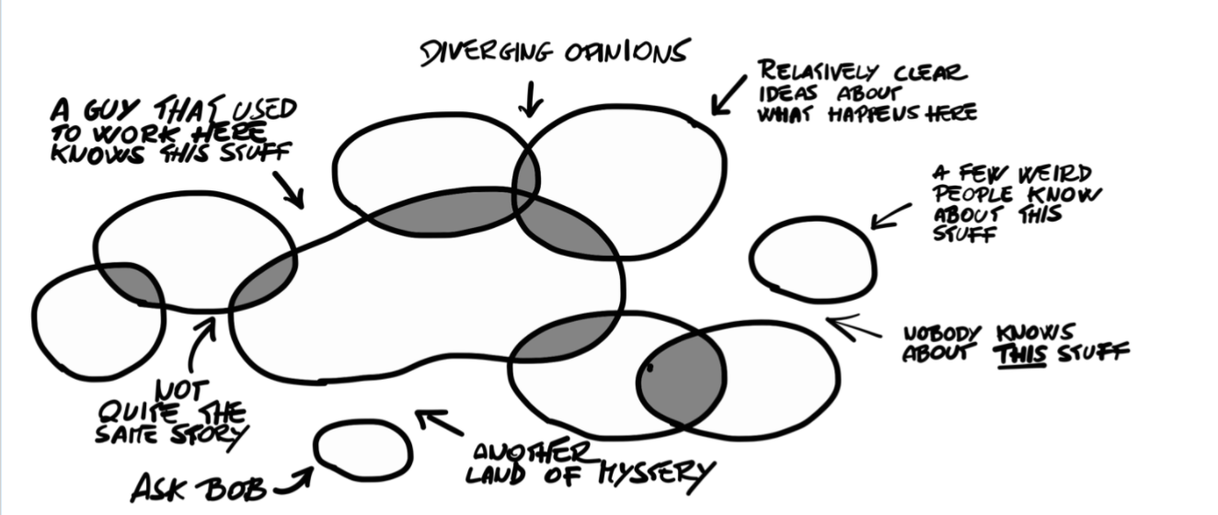
Notes:
Because procedure is largely based on precedent, no one story can ever be taken as the whole truth
This is a picture taken from the book Introducing EventStorming
A book we’d recommend if you’re interested in collating distributed knowledge across an organisation and beyond

Slide 18
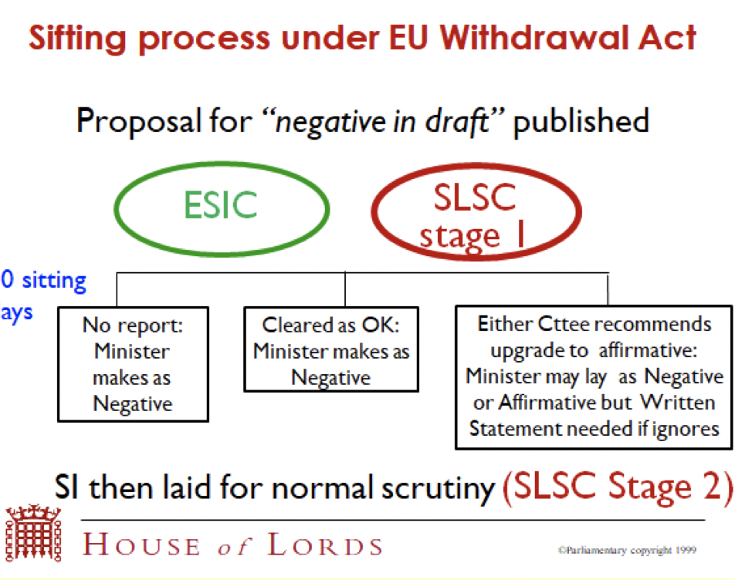
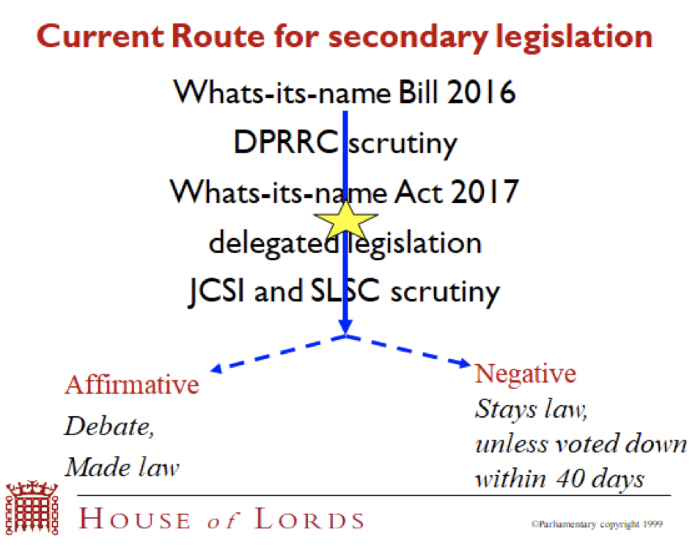
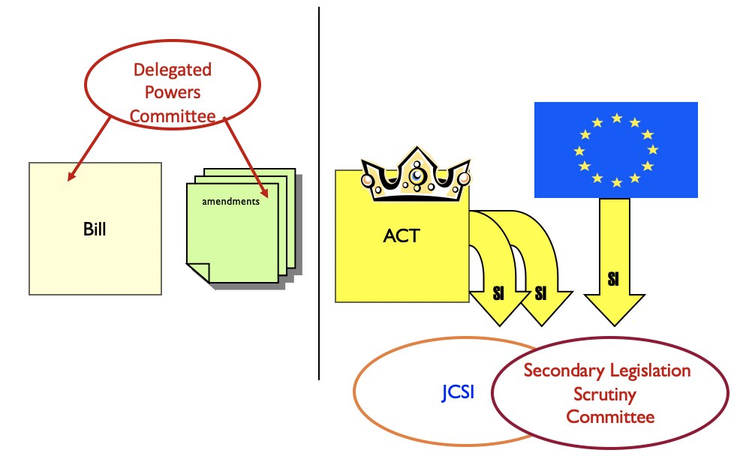
Notes:
When we first started on the SI service, the only documents we had were flowcharts
Many, many flowcharts
All drawn from a certain perspective and none complete
Over several months we talked and sketched and brought together multiple perspectives from both inside and outside Parliament

Slide 19
The procedure model
Notes:
The result was a process flow model - or as parliamentarians might say, a procedure model

Slide 20
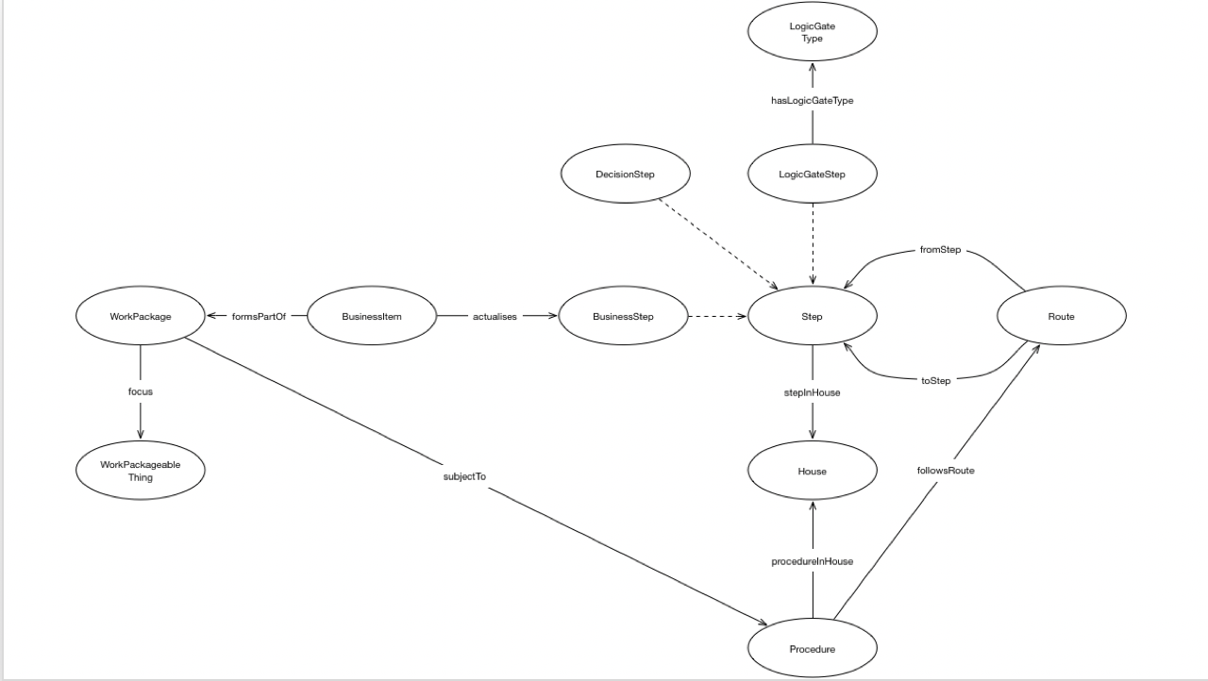
Notes:
It allows us to state this and this having happened and this other thing not having happened or this other other thing being scheduled to happen then this thing is either caused to happen, allowed to happen or precluded from happening
It is a model of two halves

Slide 21
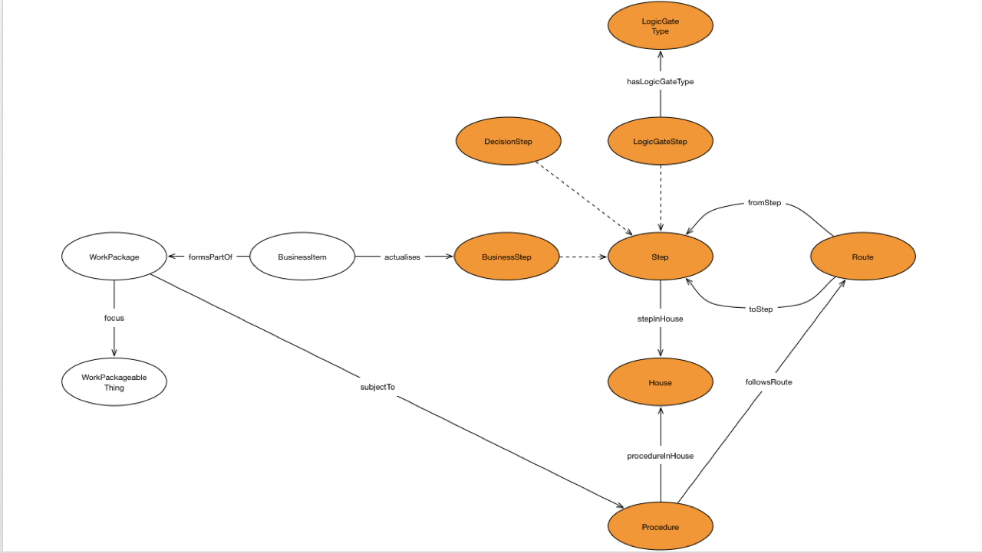
Notes:
On the right are steps - with types - linked by routes forming a procedure
We sometimes use the analogy of stepping stones across a stream

Slide 22
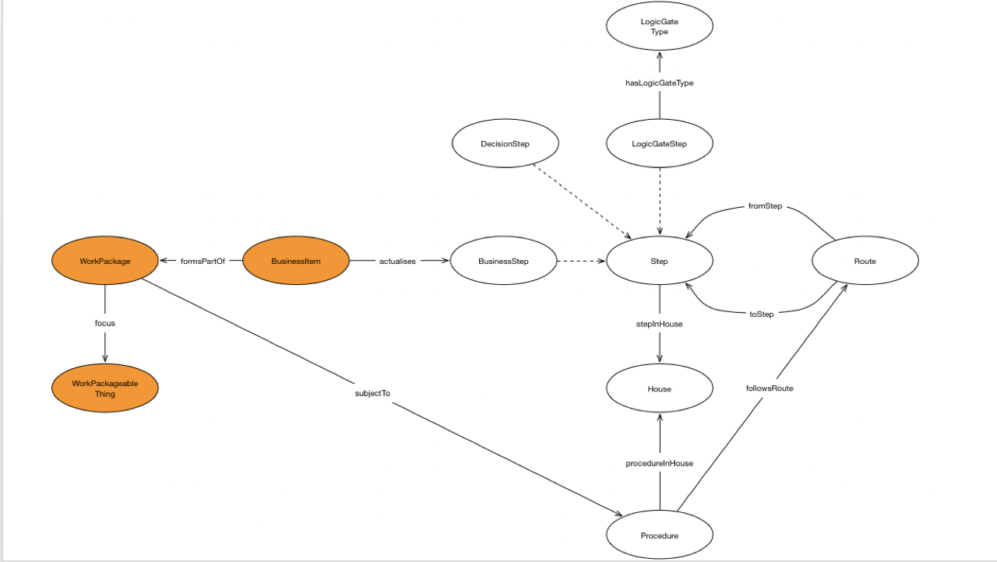
Notes:
On the left are the things subject to a procedure - be that an SI, a treaty or a bill - and the business items they generate in Parliament
And occasionally outside
A clerk would not recognise this model
It has no domain knowledge or domain language encoded
It is as capable of modelling the process for evaluating the safety standards of an abattoir as it is of describing a parliamentary procedure
We know this because we tried

Slide 23
The maps
Notes:
But on top of the abstract model we have procedural maps
All of our time with clerks and lawyers is spent mapping procedures on top of the model

Slide 24
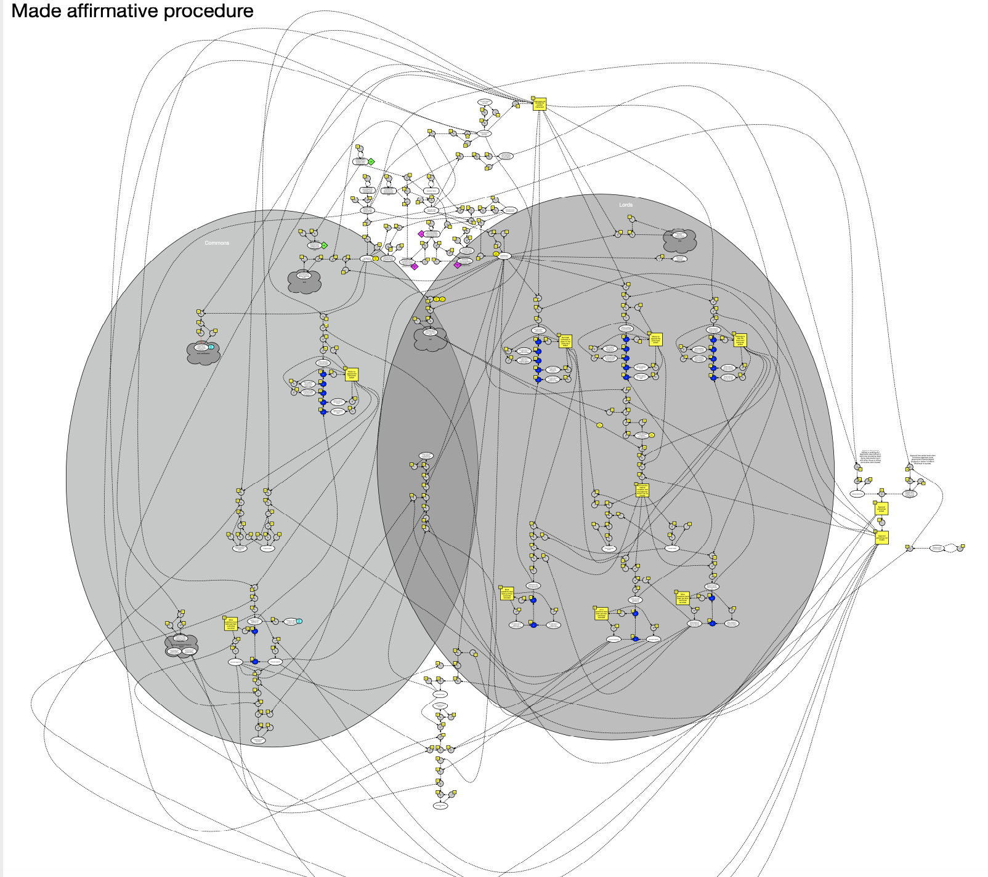
Notes:
We talk and sketch with as many different domain experts from as many different offices - inside and outside Parliament - as possible
The knowledge to describe procedural possibilities being distributed across Commons clerks, Lords clerks and lawyers
The results ends up looking like this: the made affirmative statutory instrument map

Slide 25
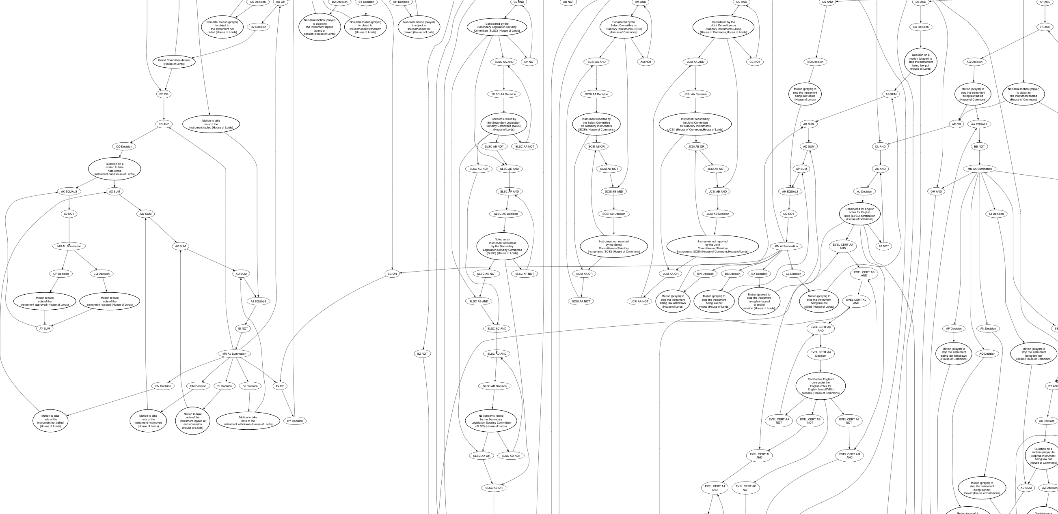
Notes:
And this is a small part of the made negative procedure as drawn by a machine

Slide 26
The cult of user needs
Notes:
A word about user needs
You may have noticed that we’ve talked about mapping the domain but not about what users might need from such a service
In truth we find that an emphasis on user needs isn’t particularly helpful to our work
By concentrating on describing the domain we don’t lock ourselves into single solutions and new possibilities are emergent from materials
Not only do needs differ across user groups but sometimes our users have needs that are diametrically opposed to the needs of others
This being the nature of politics

Slide 27
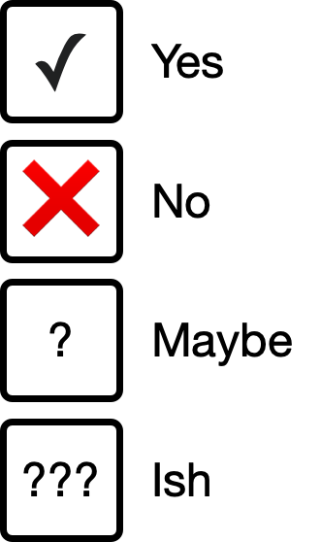
So is this Rules as Code
Notes:
Procedure is informed by several strata of what one might - perhaps mistakenly - call “rules”

Slide 28
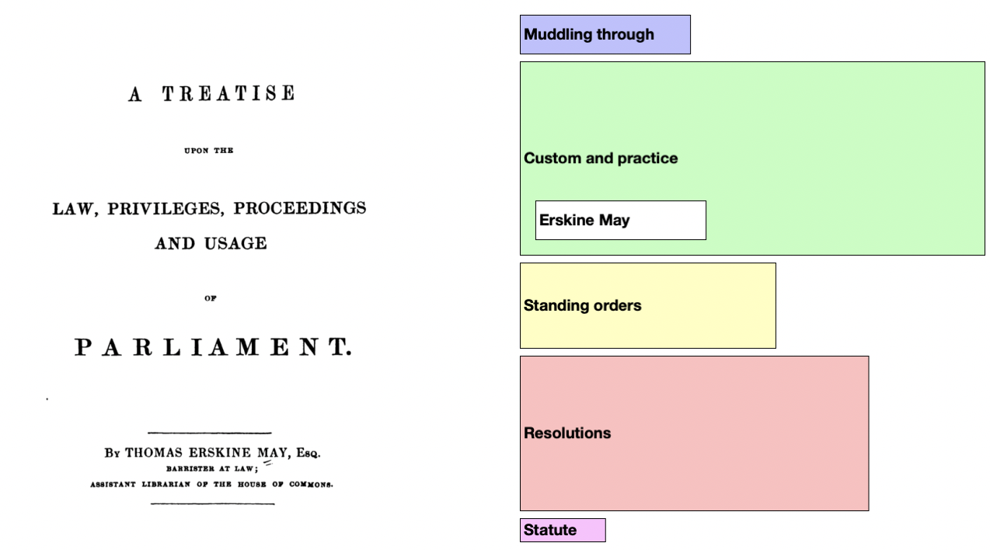
Notes:
This is a picture we stole from Paul Evans - retired Clerk of Committees in the House of Commons
It shows the components that inform procedure
The further down the stack the more immutable
The wider the bar the greater the coverage
So in order to map procedure we need to take account of legislation, standing orders, speaker rulings and precedence - hello Erskine May
And we also need to take account of “muddling through”
Because improvisation is how a lot of things work
Nothing we do to describe procedure to machines precludes information managers from taking what the machine says should be true and doing something different
We put our trust in librarians and domain experts, not machines

Slide 29
Parliament is not complicated
Notes:
At this point we tend to invoke the Cynefin framework

Slide 30
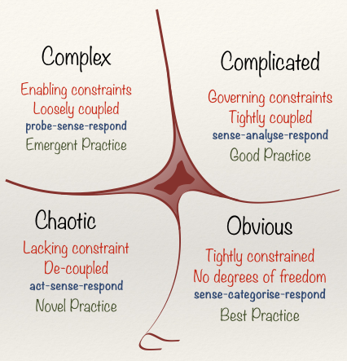
Notes:
Much software has been written on the assumption that Parliament operates in a complicated space
This is not true
Parliament is a complex adaptive system
”Rules” are malleable
See, for instance, the Speaker’s interpretation of motions to be put forthwith in the Brexit debates
Tightly coupling the implementation of software and data models to defined rulesets makes the software and its resulting information brittle and liable to break under change
So whilst the procedure model can be interpreted as conservative on output, it is always liberal on input

Slide 31
Finally

Slide 32
Notes:
The result of all this is the website that Parliament asked for
And a website that can flex and adapt as Parliament flexes and adapts

Slide 33
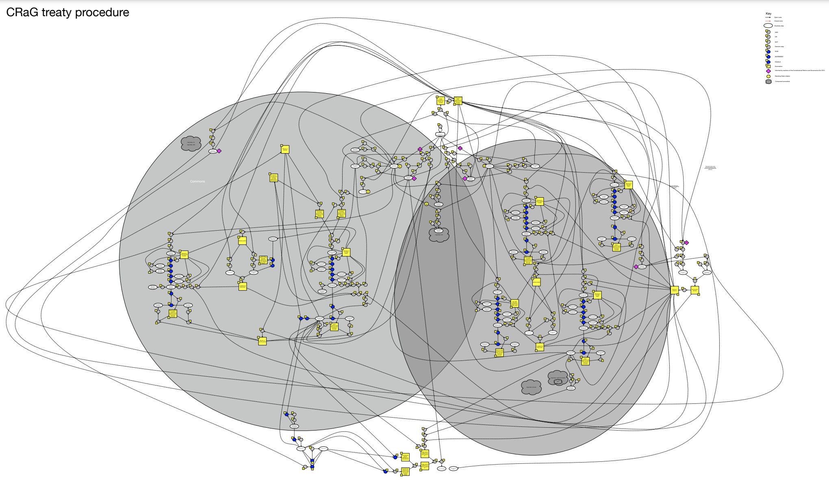
Notes:
But by understanding the domain, choosing the right bounded contexts we can do more
We took the same model and – with relatively little work - overlaid a map of the procedure for treaties laid under the Constitutional Reform and Governance Act
And with almost no work made a website and a library of queries for treaty procedure too

Slide 34
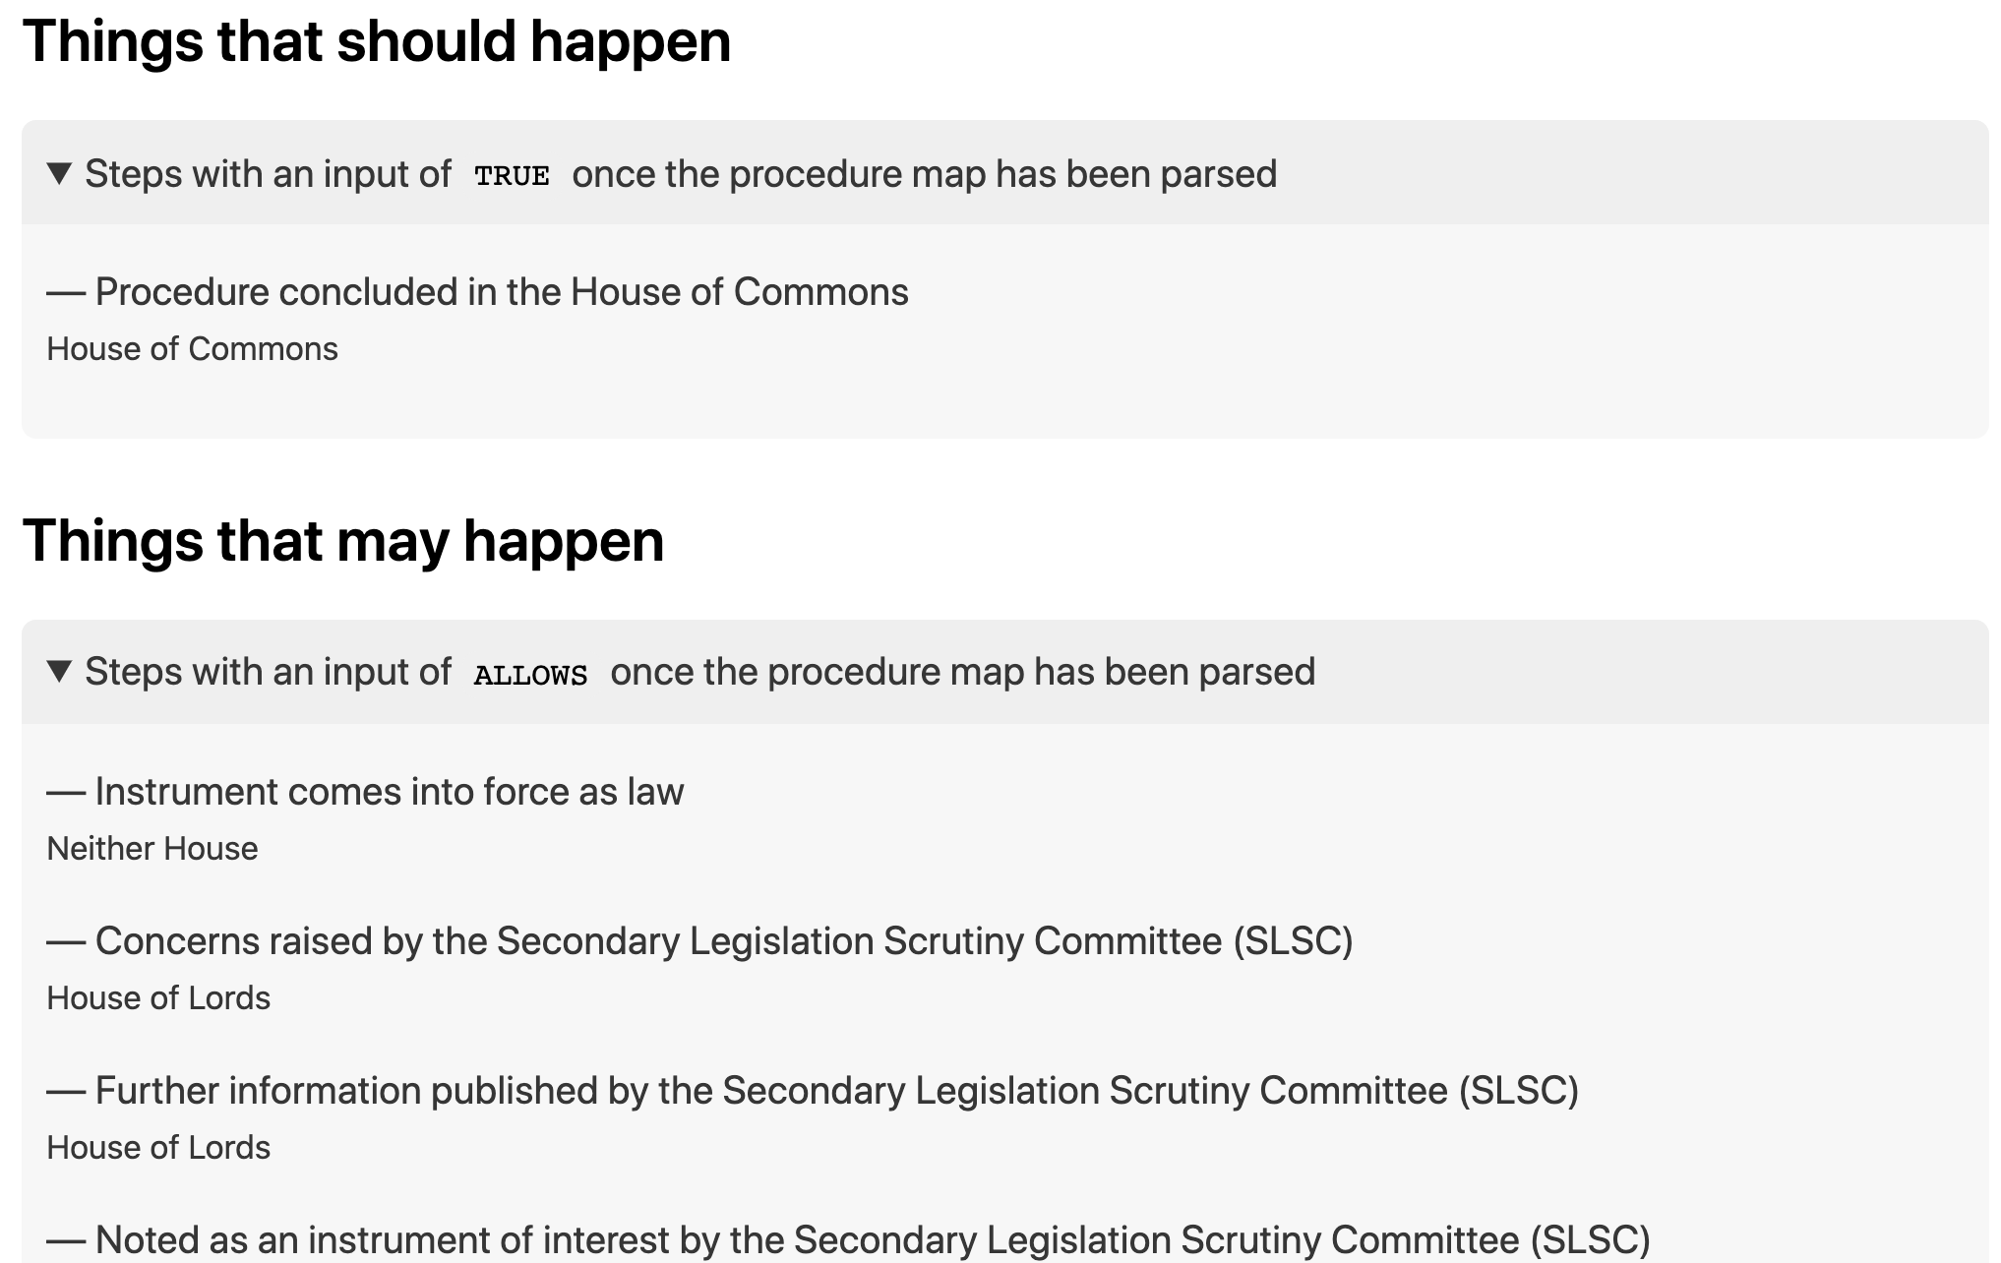
Notes:
Regardless of the procedure map, the model is capable of being parsed by machines to determine - from what has happened - what should happen and may happen and should not happen next

Slide 35
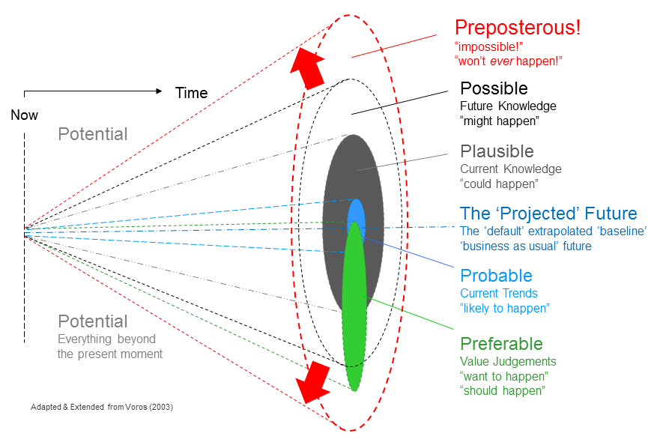
Notes:
We call this the light cone of procedural possibilities
The knowledge required to describe this light cone is encoded in the procedure maps
We can use this parsed data alongside the identification of “intervention” steps to signal to Members - and to lobbyists, journalists and civil society - when points of intervention become possible

Slide 36
Querying for precedence
Notes:
And if you’re a researcher, we now have a pot of data we can query for precedence
When did X and Y both happen when Z didn’t

Slide 37
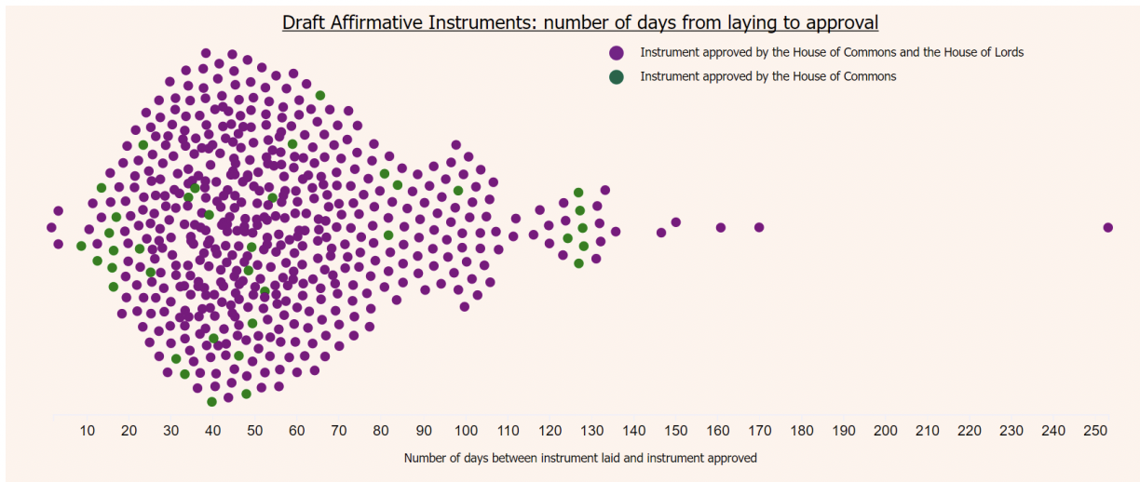
Notes:
And to look for patterns across sessions worth of Sis
Questions like: which department laid the most SIs in the 2017-19 session?
This is one example showing the number of days between laying and approval of draft affirmative instruments
HT Phil Gorman in the Commons Library
This is available online allowing you to hover over each dot and see the name of the instrument and the exact number of days
More importantly, it is repeatable
====
The instrument that took the longest time is the Crime and Courts Act 2013 (Commencement No. 18) Order 2018, at 253 days.
And the shortest: European Union (Withdrawal) Act 2018 (Exit Day) (Amendment) Regulations 2019, with two days between laying and approval.
https://mognar.github.io/parly-data/draftaffirm.html - you can hover over the points and see the name of the instrument and the exact number of days between laying and approval.

Slide 38
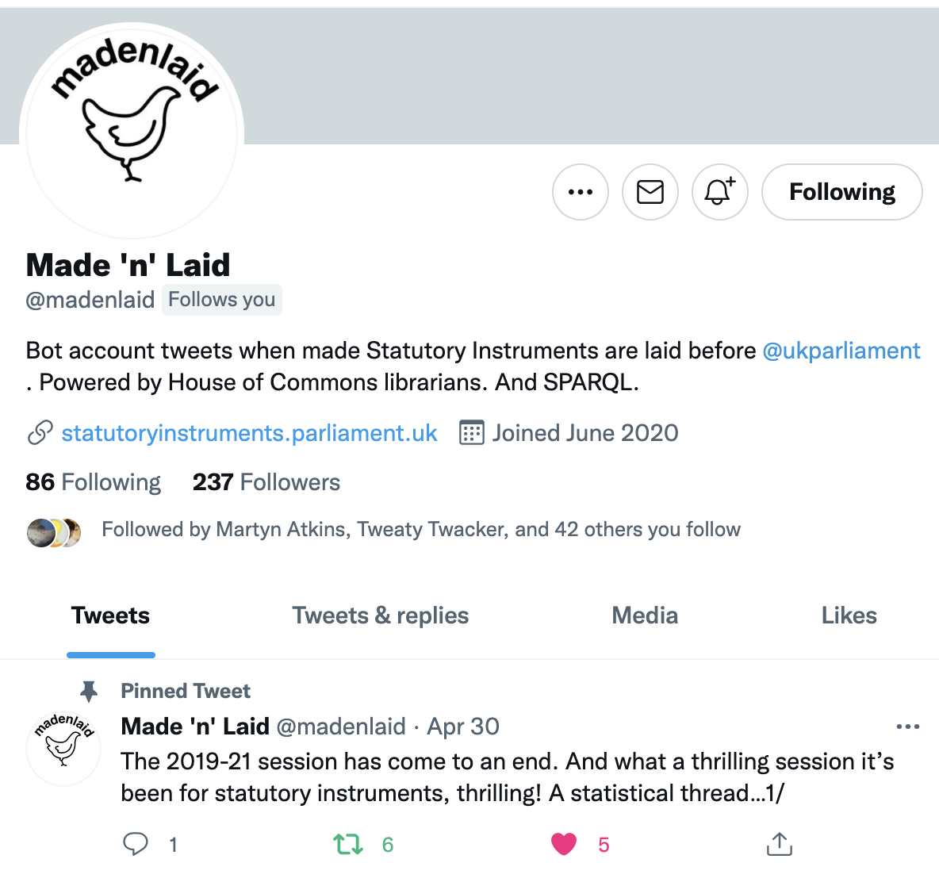
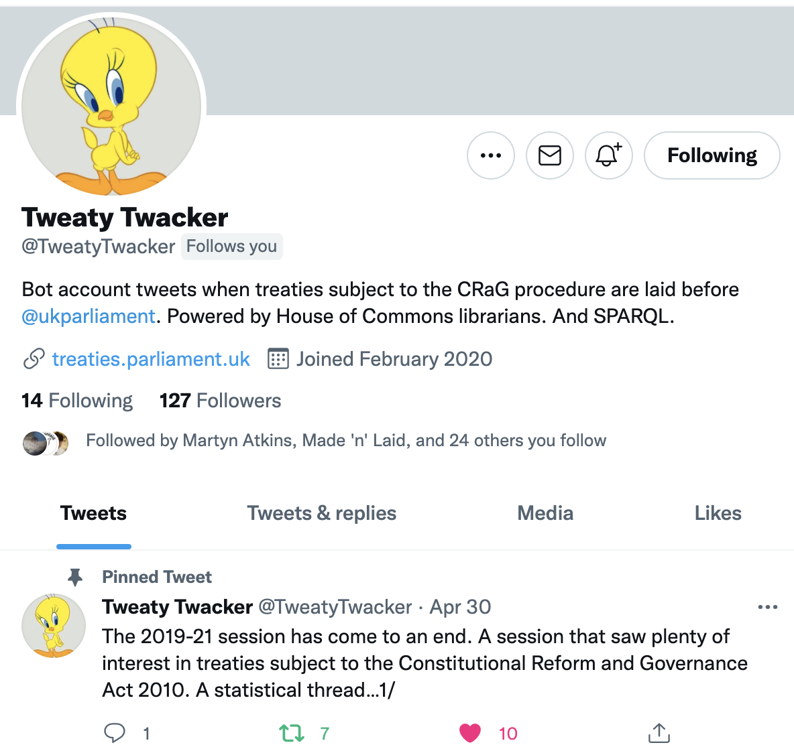
Notes:
And we can build new services on top
Nobody asked for twitter bots for SIs and treaties before Parliament but a couple of hours work and we now have 237 people following avidly

Slide 39
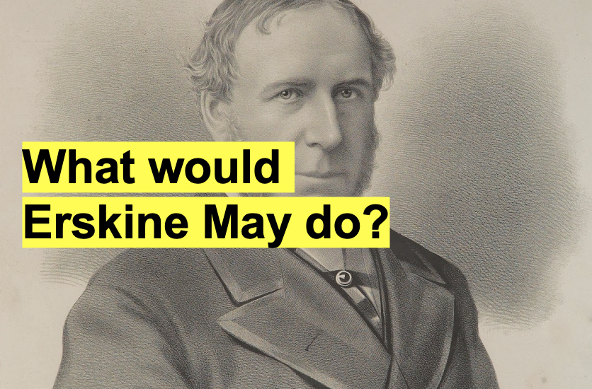
Notes:
In summary
Information management is hard work
Understanding the domain - given the number of people with slightly different views - is not quick
But well modelled, well managed information is generative
Possibilities emerge when you take the time and trouble to understand the domain and care about it
We often ask ourselves – if Erskine May had had a computer – what would he have done
We think possibly…
If he’d had a computer, he would have used it to build a graph of knowledge of parliamentary business
And built a precedence engine out of data
Thank you

